Slide 1

Danail Arabadzhiev
October 9, 2024

Slide 2

Outline
Executive Summary
Introduction
Methodology
Results
Conclusion
Appendix

Slide 3
Executive Summary
The project involves collecting data using SpaceX's API and web scraping Wikipedia, followed by data wrangling techniques like handling missing values and encoding variables. Exploratory data analysis (EDA) and visual analytics are performed using visualization tools, SQL, Folium, and Plotly Dash, leading to predictive analysis through classification models, including model building, tuning, and evaluation.
Picking the optimal orbit, payload mass and launch site, as well as the advancement of technology can greatly affect the result of a landing.

Slide 4
Introduction
The Falcon 9 rocket is designed to have its first stage return and land safely after launch, allowing it to be reused for future missions. This reusability is a key factor in reducing costs, and accurately predicting whether the first stage will land successfully is crucial for planning and budgeting.
By leveraging historical data, the project aims to build a predictive model that can estimate whether a Falcon 9 first stage will successfully land. This could help SpaceX optimize its launch processes.
Key questions that we want to see answered during our project are the following:
What factors influence a successful landing?
What is the probability of a successful landing under different conditions?
Can the success rate be improved by adjusting certain parameters?
How accurate is the current prediction model for Falcon 9 landings?

Slide 5

Section 1

Slide 6
Methodology
Executive Summary
Data collection methodology:
SpaceX’s API was used together with the webscraping of a Wikipedia page about the Falcon rockets.
Perform data wrangling
A few techniques were use such as handling missing values, filtering rows, creating new variables, encoding categorical variables, data type conversions and more.
Perform exploratory data analysis (EDA) using visualization and SQL
Perform interactive visual analytics using Folium and Plotly Dash
Perform predictive analysis using classification models
How to build, tune, evaluate classification models

Slide 7
Data Collection
The data was sourced from SpaceX’s API and Wikipedia.
SpaceX API: Using Python’s requests library, I fetched the API URL, extracted a JSON file with .json(), and used pandas.json_normalize to convert it into a DataFrame.
Wikipedia Scraping: I used BeautifulSoup and requests to access and parse the relevant Wikipedia page. By locating the specific table, I extracted and cleaned the required data.

Slide 8
Data Collection – SpaceX API
Firstly we import a few important libraries like “requests” and “pandas”. I had a few given functions that loop through a few of the APIs pages. After that we fetch the data with the requests library and the get function. Then we normalize the data with pd.json_normalize and save it into a variable as a DataFrame object.
Here is a GitHub link where all the files on this assignment are situated: https://github.com/Danail-A/capstone_project
For this you can use jupyter-labs-spacex—data-collection-api.ipynb file.
Start
Import libraries
Define Functions
Fetch SpaceX Launch Data
Normalize JSON data
Save the data into a DataFrame

Slide 9
Data Collection - Scraping
Firstly I import a few important libraries like requests, pandas, and bs4 for the BeautifulSoup object. Again here the main functions were defined. I again use the requests library and the get function to get the data from the URL given. I use the BeautifulSoup with the text of the URL to get the information from the website. With this I can find all the tables with {html_tables = list(soup.find_all('table’))}. After finding the needed table I fetch the data from it and save it into a dataframe (more on this in the data wrangling section).
You can use the jupyter-labs-webscraping.ipynb file.
Start
Import Libraries
Define Functions
Fetch HTML data from Wiki
Find all the tables
Save the Data into a df

Slide 10
Data Wrangling – SpaceX API
After loading the data into a DataFrame from the API:
Trimming Columns: Kept only “rocket,” “payloads,” “launchpad,” “cores,” “flight_number,” and “date_utc.” Rows with multiple cores/payloads were removed, and “date_utc” was converted to datetime format.
Filtering Data: Extracted information for Falcon 9 boosters, including Booster Version, Payload Mass, Longitude, Latitude, and Outcome.
Handling Missing Values: Checked for missing data, which was found only in the Payload Mass column; filled these using the mean of other entries.

Slide 11
Data Wrangling - Scraping
After finding which table to use for the WebScraping:
Identify Table Headers: Located the relevant table and stored its headers using first_launch_table.find_all('th’). Used the extract_column_from_header function to gather all necessary columns.
Create Data Dictionary: Initialized a dictionary with column names as keys and empty lists as values.
Iterate Through Table Rows: Used a predefined function to loop through each row in the table ("wikitable plainrowheaders collapsible"). Verified if the row's header contained a flight number and if it was a digit to confirm it as a valid record.
Extract and Store Data: Extracted relevant information for valid records and assigned it to the correct keys in the dictionary. After the process was complete it was loaded into a DataFrame.

Slide 12
EDA with Data Visualization
The main charts used in this section were created in order to see the relationship between Flight Number, Payload Mass, Launch Site, Orbit and Year with Success. The reason they were created was in order to find visible correlation between the above mentioned variables.
edadataviz.ipynb is the file where you can in detail see the specific charts created.

Slide 13
EDA with SQL
Display the names of the unique launch sites in the space mission – pretty explanatory. It is really needed to know all the launch sites as it might be a major factor.
Find the payload mass carried by boosters launched by NASA
Find the first date when there was a successful landing
Find the total number of successful and unsuccessful mission outcomes
List the names of the booster versions which have carried the maximum payload mass
Jupyter-labs-eda-sql-coursera_sqlite.ipynb is the file where you can see my SQL queries.

Slide 14
Build an Interactive Map with Folium
The objects used in the creation of the map were Map, Markers, MarkerClusters, Circles, PolyLines, MousePosition and Icons.
Map was used to initiate the map object where everything else was later added on. The reason markers were created at the beginning was to mark a point on the map where there was a launch site. Later they were used to pin-point the shore, town, railroad and highways with the help of the MousePosition indicator. MarkerClusters were used as there were a lot of markers with the same location and it made it hard to see how many of them were successful or not. Quite a useful tool. PolyLines were used to connect two points. Icons were used just for visuals. Circle was used around the marker points to visually create an area around them.
You can use the lab_jupyter_launch_site_location.ipynb file for more visuals and info.

Slide 15
Build a Dashboard with Plotly Dash
In this project I have added a dropdown menu and a range slider in order to make the charts interactive. With the dropdown menu you can select a specific launch site and see what is the percentage of successful launches from this specific site in the form of a pie chart. The range slider has a range of minimum of payload to maximum of payload and when it moves the graph below, which is a scatter plot that shows the successful launches per selected side, moves with it.
These interactions were added because it can easily show the ways these two things interact with the success rate and visually is the easiest way for this information to be understood.
spacex_dash_app.py is the file where you can check this.

Slide 16
Predictive Analysis (Classification)
The way the machine learning models were build is pretty straightforward. As in the previous steps there was a normalization step where I used one-hot encoding to convert the categorical data into numeric so the data was ready to be fed to the models. The models used are Logistic regression, Support Vector Machines, Decission tree, and KNN as they are good for classification prediction.
The way the models were build was with GridSearchCV. The data set was preprocessed using preprocessing.StandardScaler() and fit_transform. Then it was split into training and testing with train_test_split with test_size=0.2. GridSearchCV was used to calculate the best values for the parameters which we use from a predefined list of parameters. Then the train data is fit to the best parameters in order to provide a prediction on the test data. Weirdly all the models give the same predictions with accuracy of around 83% with Decision Trees providing a best score of 90.18% on the training data.
SpaceX_Machine Learning Prediction_Part_5.ipynb is the file for this

Slide 17
Results
One of the important conclusion that could be seen from the EDA is that with the larger the Payload Mass and the larger the number of flights, the better the chance of a successful landing. Later we can see that for some orbits they Payload mass is an important factor as their success landings are getting more and more prominent with larger payload mass. Also with years success rate tends to get much better especially since 2013.
All the methods used bring the same result being 83% on the test data. Decision trees bring the best result at 90% for the training data.

Slide 18

Section 2

Slide 19
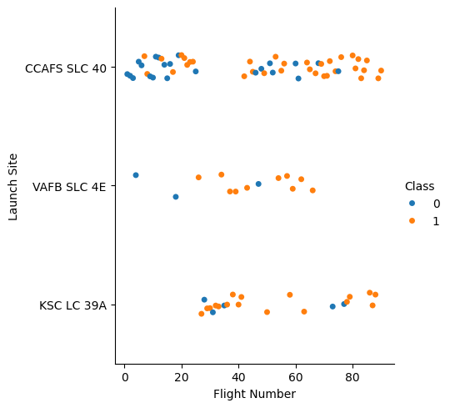
Flight Number vs. Launch Site
From the above scatter plot we can clearly see that the higher the flight number the better the success rate for each site. We can conclude that there is a positive correlation between the two.

Slide 20
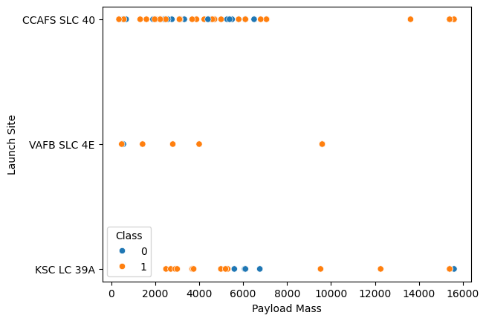
Payload vs. Launch Site
What we can see is that for the CCAFS SLC 40 launch site the higher the Payload mass the more successful the landings. However, we cannot say the same for the other sites as we do not have a clear indications based on the few samples.

Slide 21
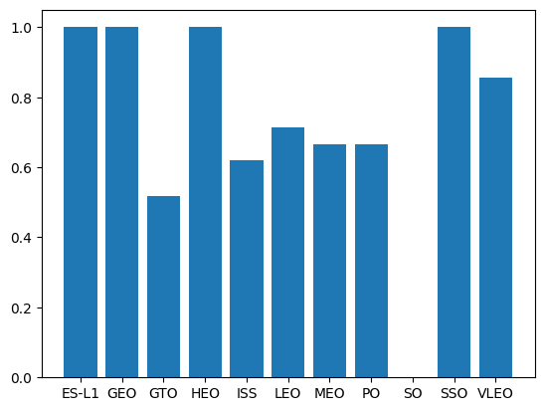
Success Rate vs. Orbit Type
We can observe that for some orbits like ES-L1, GEO, HEO and SSO have a success rate close to 1. Just from this information there isn’t much more to be drawn. Later we can see that for some of them we just have too little data (like 1 sample).

Slide 22
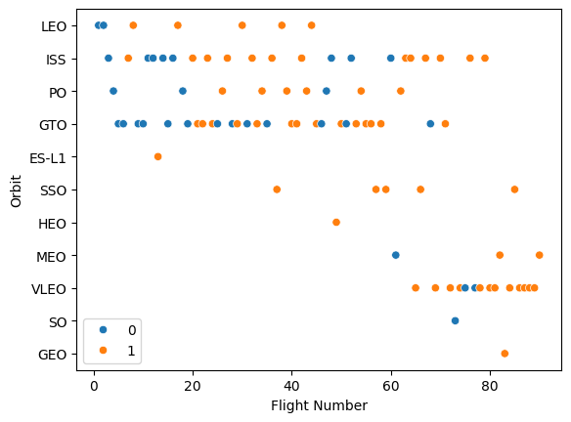
Flight Number vs. Orbit Type
We can observe that for some orbits like VLEO, ISS and LEO the more the flight number increases the better the odds. Still, we cannot conclude that for all the orbits.

Slide 23
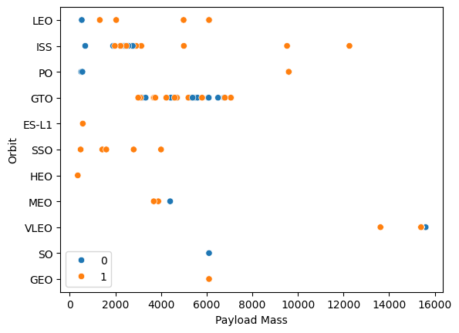
Payload vs. Orbit Type
With heavy payloads the successful landing or positive landing rate are more for LEO and ISS.
However, for GTO, it's difficult to distinguish between successful and unsuccessful landings as both outcomes are present.

Slide 24
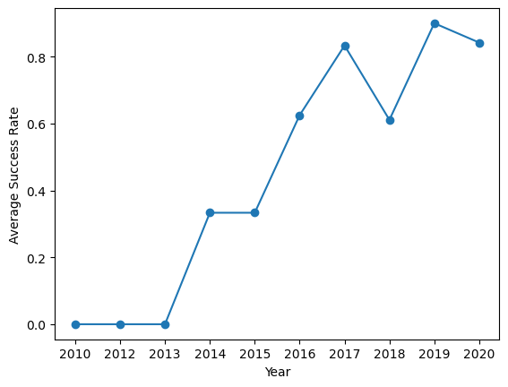
Launch Success Yearly Trend
As beforementioned we can see a clear uptrend starting from 2013. This probably is due to the advancement of technology.

Slide 25
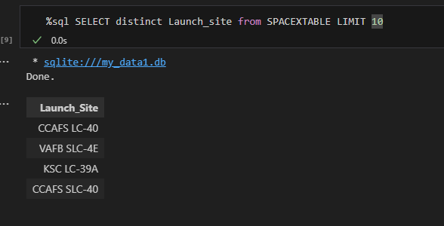
All Launch Site Names
Here we can see all launch sites.

Slide 26
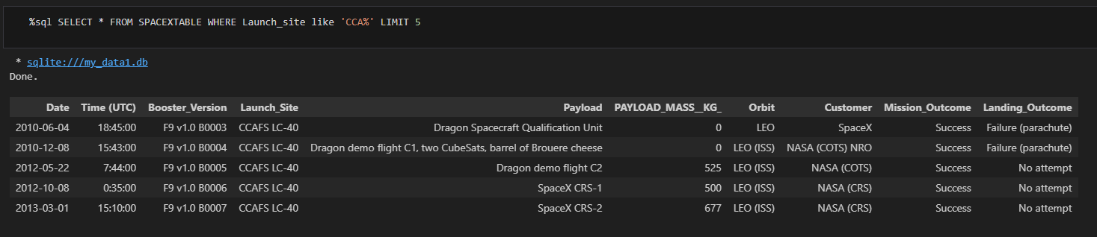
Launch Site Names Begin with 'CCA'

Slide 27
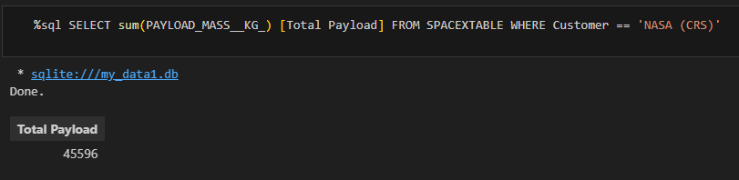
Total Payload Mass

Slide 28
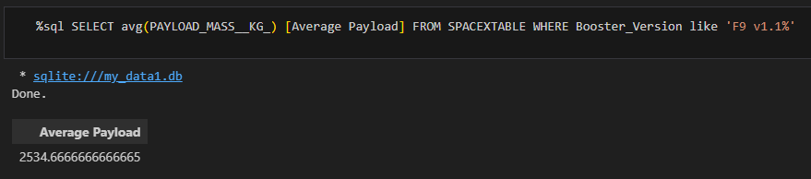
Average Payload Mass by F9 v1.1

Slide 29
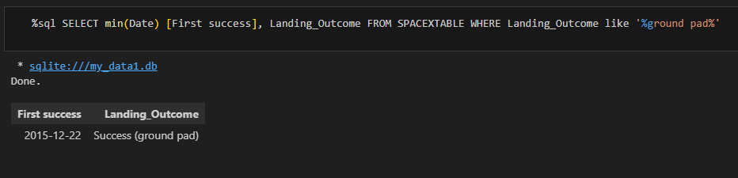
First Successful Ground Landing Date

Slide 30
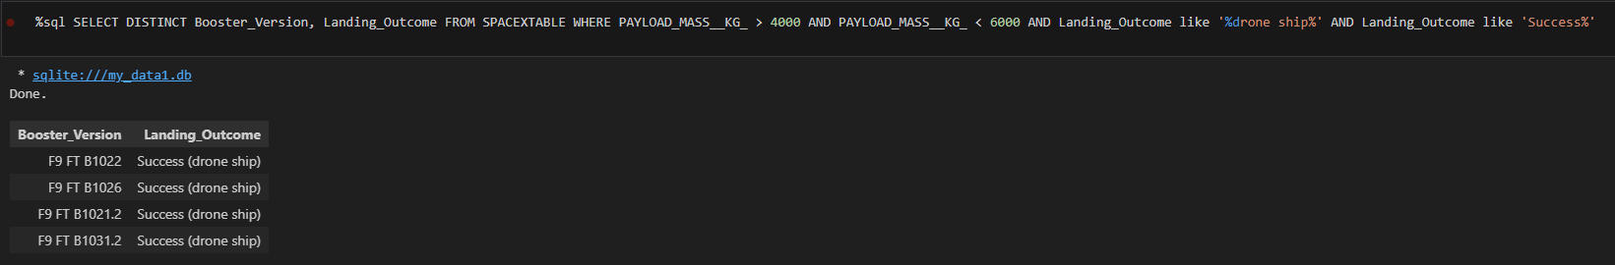
Successful Drone Ship Landing with Payload between 4000 and 6000

Slide 31
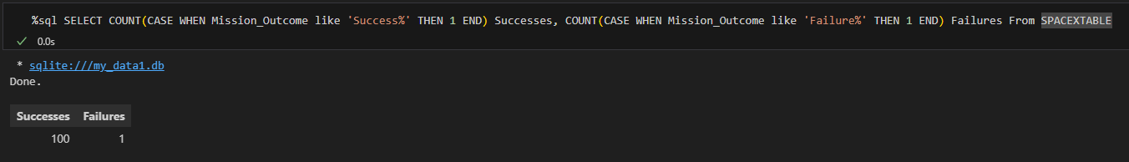
Total Number of Successful and Failure Mission Outcomes

Slide 32
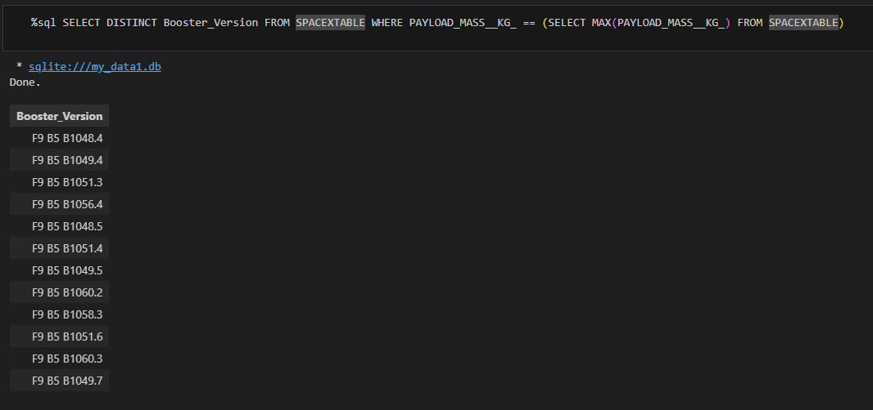
Boosters Carried Maximum Payload

Slide 33
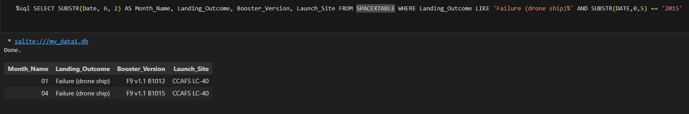
2015 Launch Records

Slide 34
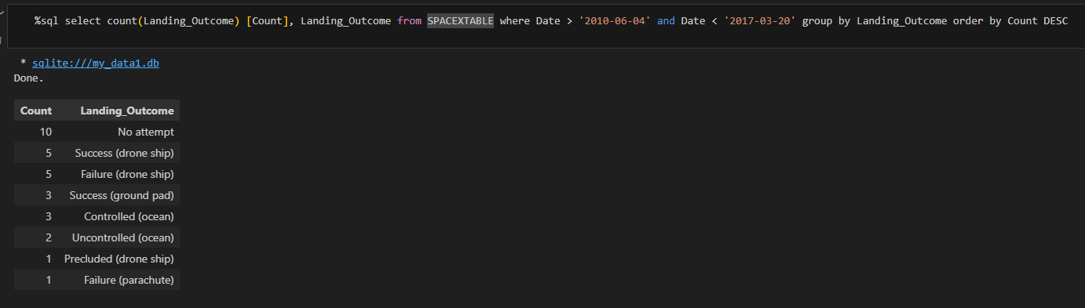
Rank Landing Outcomes Between 2010-06-04 and 2017-03-20

Slide 35

Section 3

Slide 36
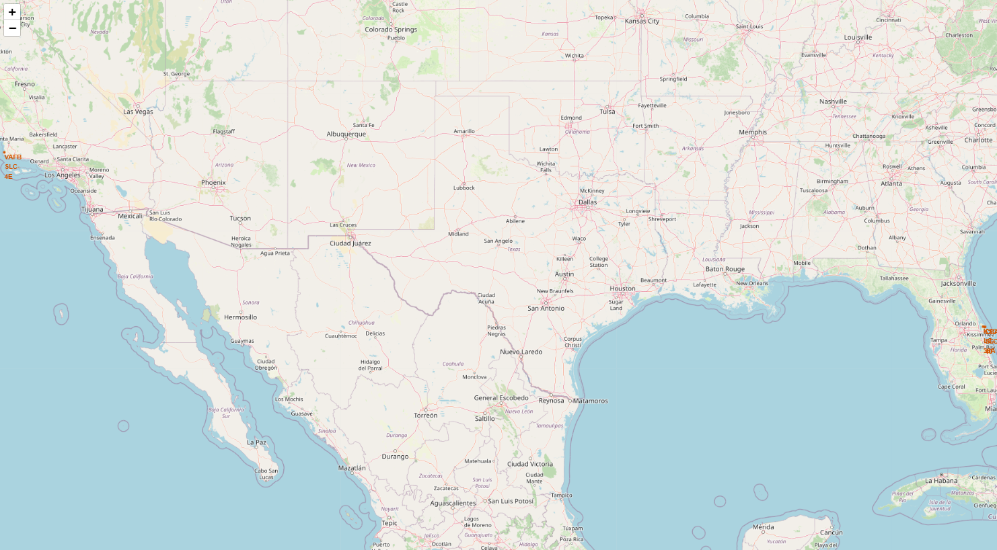
Launch Sites’ Location
From what we can barely see on the map 3 of the 4 sites are situated on the east coast and one on the west coast. Also all of the 4 are in a very close proximity to the ocean. The reason for that being is safety.

Slide 37
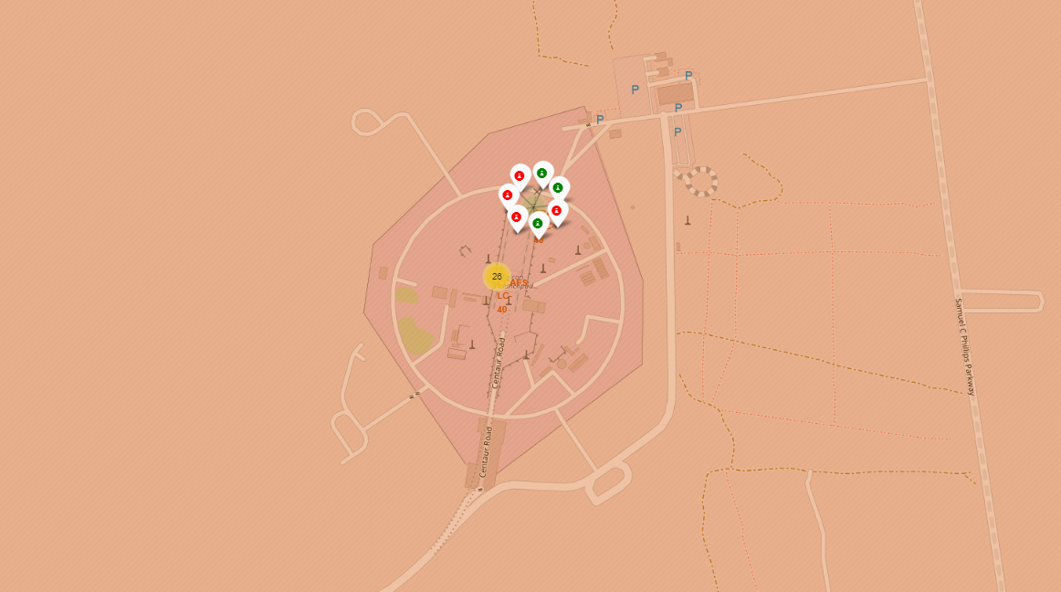
Launch Outcome by Site
Here we can see clustered all the data we have on each site. What is important and useful is that we can see how many trials are on each site and by clicking on the number we can see how many of them are successful and how many have failed.

Slide 38
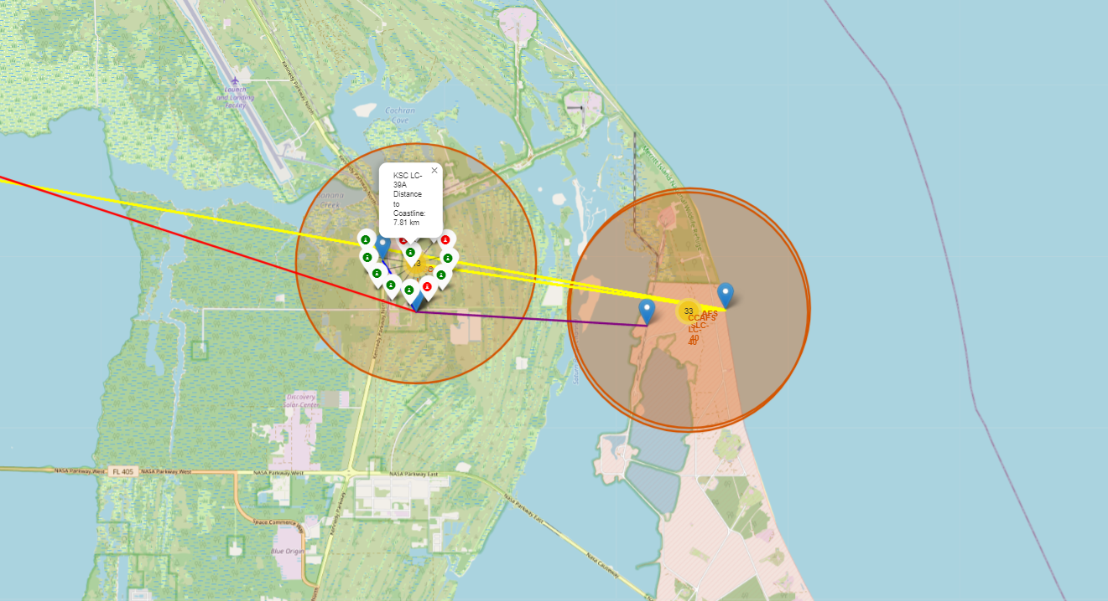
Proximity Map
From this map we can see the close proximity of the sites to things like cities, highways, railroads and coastlines. All of them are in close proximity to the coast and also to a railroad and highway. They are relatively distant from cities. All seems reasonable as for the safety measures beforementioned.

Slide 39

Section 4

Slide 40
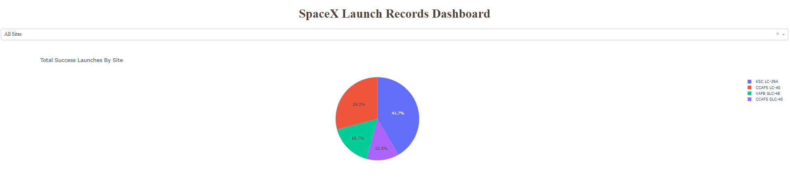
Total Success Launches By Site
We can see from this screenshot that KSC LC-39A is the launch site with the most successes.

Slide 41
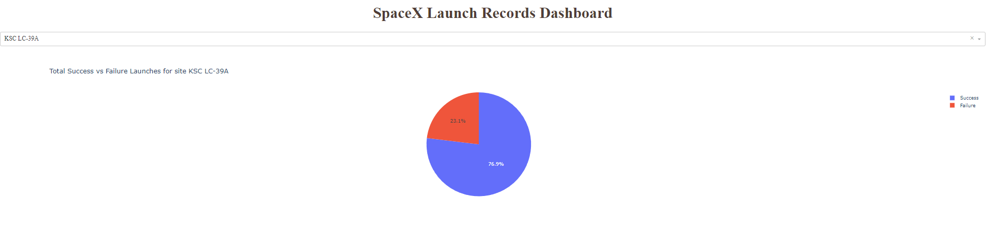
Best Success Rate Site
Here we can see the chart for the site with best success rate. KSC LC-39A is the most reliable site by much.

Slide 42
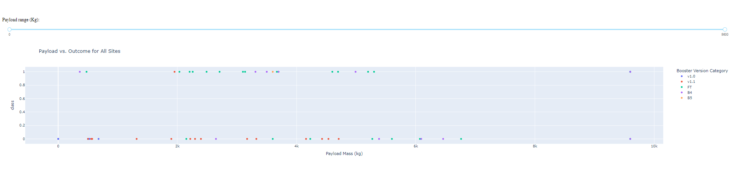
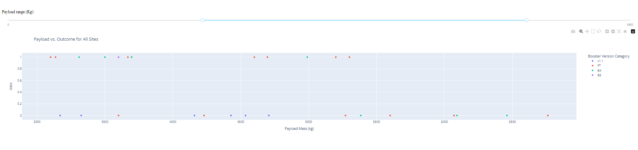
The things we can see from these two charts of Payload vs. Outcome is that the booster version FT has most of the successful landings. Also we can see that most of the trials are withing the 2k to 4k payload mass and there is no clear correlation between payload mass and success.

Slide 43

Section 5

Slide 44
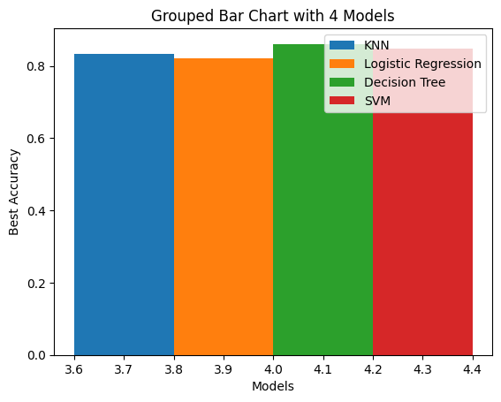
Classification Accuracy
Although all the 4 models have yielded the same confusion matrix with the same accuracy on the testing data, decision trees has yielded above 90% accuracy as a best score.

Slide 45

Confusion Matrix
This is the confusion matrix for the decision tree.
True Postive - 12 (True label is landed, Predicted label is also landed)
False Postive - 3 (True label is not landed, Predicted label is landed)
This model predicts landed when it shouldn’t. Incorrectly predicting positive results might be bad in the future as incorrectly predicting negative results might at least

Slide 46
Conclusions
There is a close relation between the flight numbers and success. Also in some orbits the Payload Mass might have a positive correlation with success as well.
With the improvement of technology the success rate has risen drastically after the year 2013. It has reached a good rate of around 80-90%.
KSC LC-39A is the most reliable site by much. It has an above 70% success rate. This might be due to the fact that the data we have on this site is after 2017 only which might affect the current results.
The classification models that I have used yield similar confusion matrixes. The good thing is that they give a 83% accuracy score on the testing data.
Picking the optimal orbit, payload mass and launch site, as well as the advancement of technology can greatly affect the result of a landing.

Slide 47


